Slide 1
OCTOBER 2020
SCHOOL 23
Entry and Dismissal Plan

Slide 2
*

Slide 4
PARENT/STUDENT “MUST KNOWS” AT School 23
COVID-19 Student Attestation Forms must be completed on our school website at yonkerspublicschools.org/ps23 before your child comes to school. Please press on the link and fill out the information. Students will not be permitted into the school unless a form has been completed.
MASKS / FACE COVERINGS must be worn at all times in the building. Students will be given 3-4 mask breaks per day to get fresh air
Social Distancing Markers have been placed outside and inside our school for student and staff safety reference while travelling in the building
Staff are assigned to all hallways and bathrooms throughout the day to ensure social distancing protocols
Parents MUST be on time as per the arrival and dismissal schedule in this document, to drop off and pick-up their child to keep social distancing protocols at a premium
THERE IS NO ELT PROGRAM UNTIL 4:00PM THIS YEAR. PLEASE CHECK THE DISMISSAL TIME FOR YOUR CHILD’S GRADE

Slide 5
Track/Cohort Assignments

Slide 6
A.M. ARRIVAL PROCEDURES
8:30am – 9:05am

Slide 7
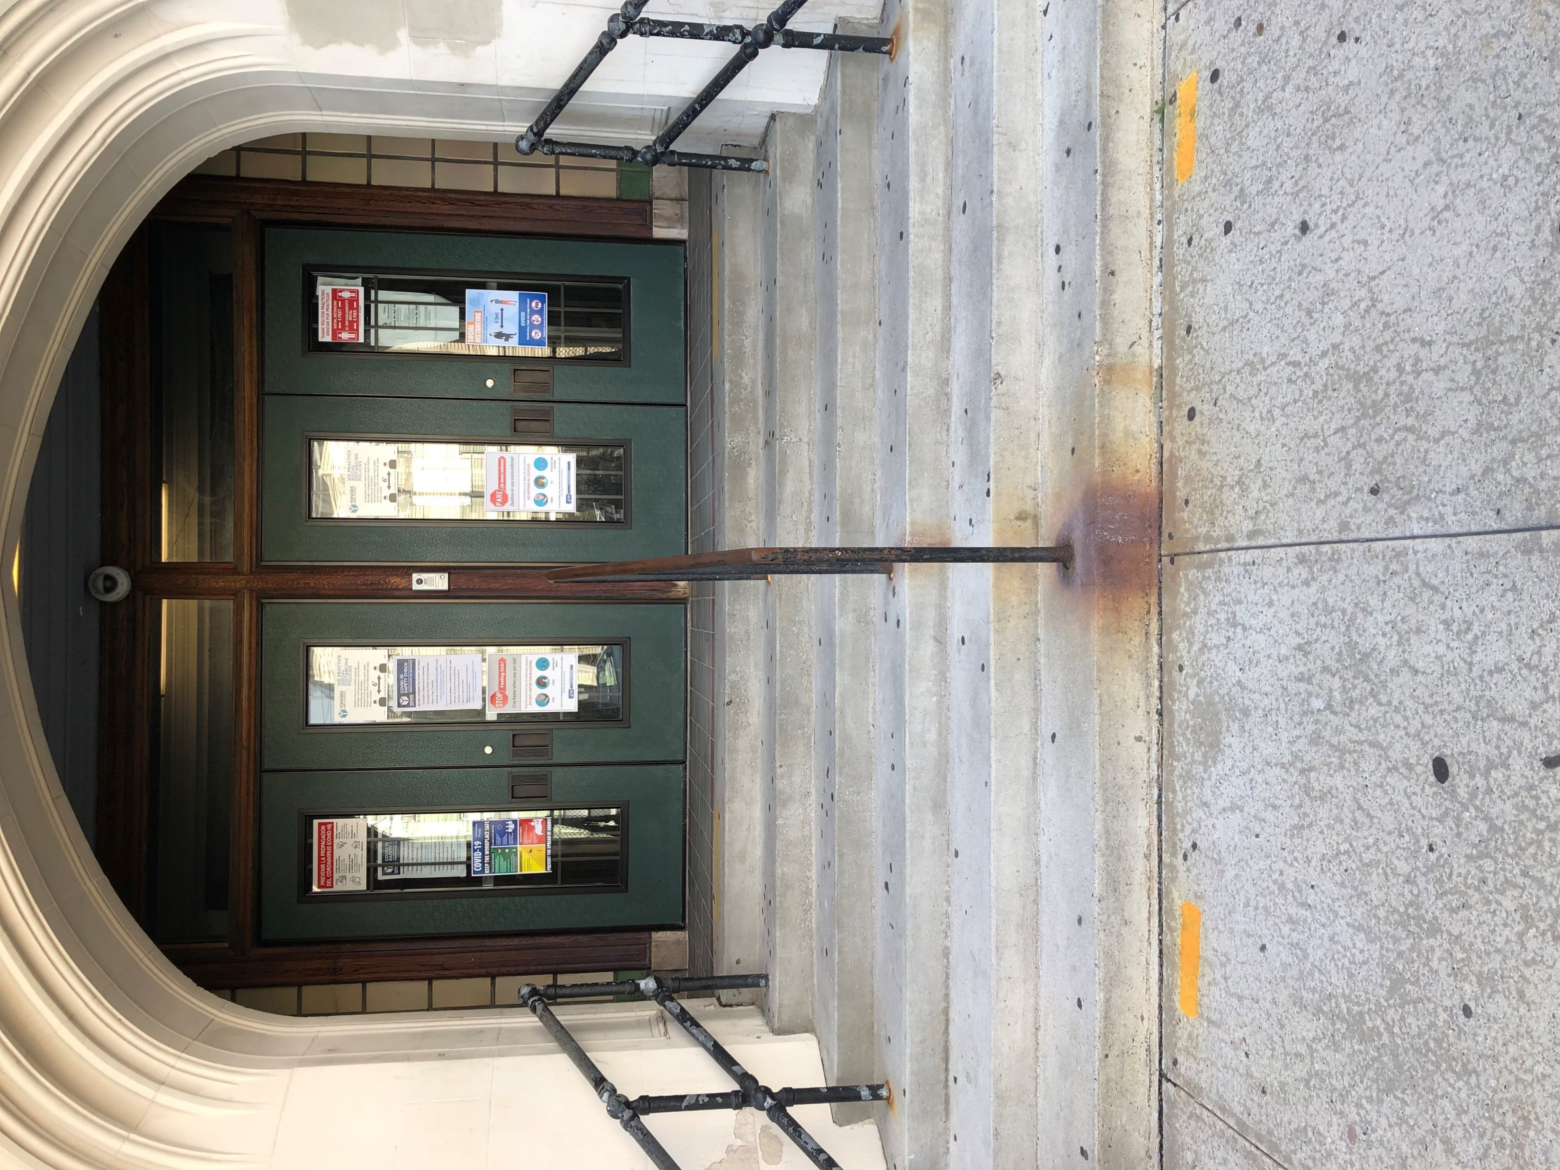
Main Entrance on Van Cortlandt Ave.
MORNING ARRIVAL
Bus Arrival times are scheduled for 8:30 a.m.-8:45 a.m.
All students will enter through Main Doors for temperature screenings
Entry/Arrival to School 23 is as follows:
*Grades PK - 4 …….. 8:30am – 8:40am
(PK, 2nd, Pascuma, Moyna,Russo) Left Walkway at MAIN ENTRANCE on Van Cortlandt Ave.
(K, 1st, 2nd, 3rd, 4th) Right Walkway at MAIN ENTRANCE on Van Cortlandt Ave.
*Grades 5 – 8………..8:45am – 9:00am
(7th and 8th Grade) Left Walkway at MAIN ENTRANCE on Van Cortlandt Ave.
(5th ,6th ,Tsagas) Right Walkway at MAIN ENTRANCE on Van Cortlandt Ave.
*Students MUST arrive at their scheduled time and maintain social distance on the markers out side the school.
* Parents are NOT PERMITTED in the school building (Non-Negotiable)
Left
Right

Slide 8
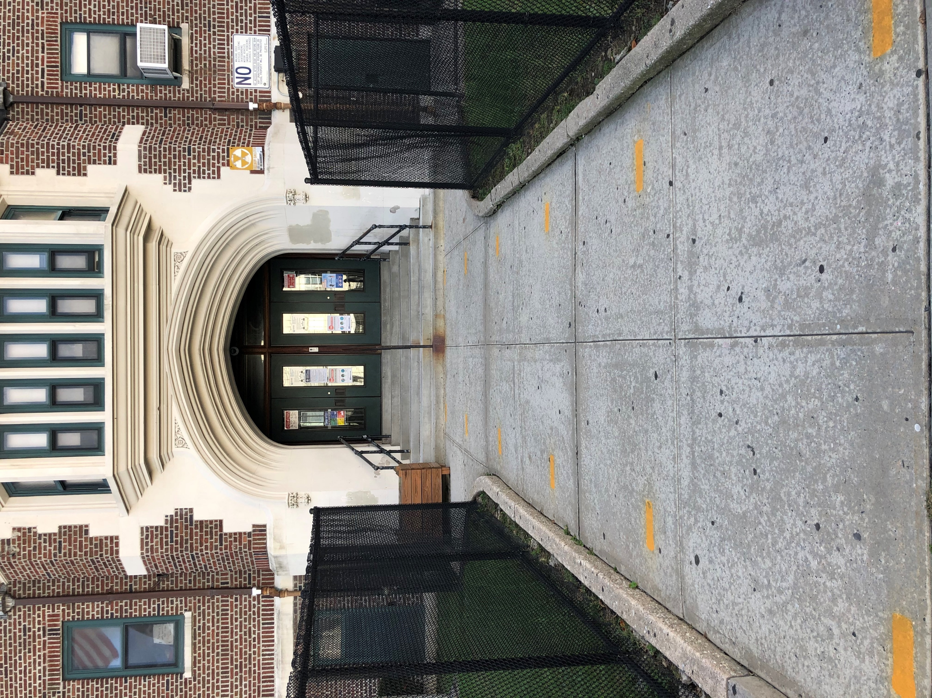
Main Entrance with 6ft. Social Distance Markers
*Students will arrive at their set time and wait on the social distance markers until it is their turn to enter the school and have their temperature checked. Check page one to confirm whether your child enters on the left walkway or right walkway They will then pick up their breakfast in a bag and go directly to class. School staff will direct and guide students to their classroom.
Left
Right

Slide 9
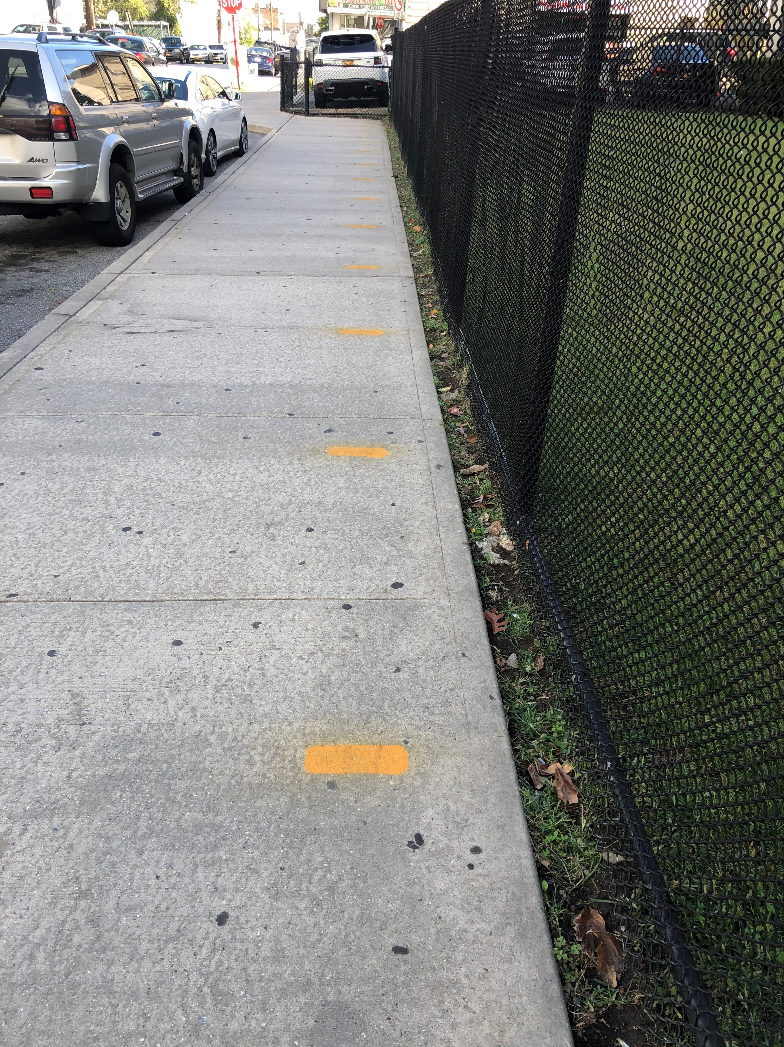
Front Sidewalk with 6ft. Social Distance Markers
*Yellow paint markers have been provided outside our school to note where students should stand while waiting to enter our building. Our staff will be outside to make sure students are following these guidelines.
6ft. Marker

Slide 10
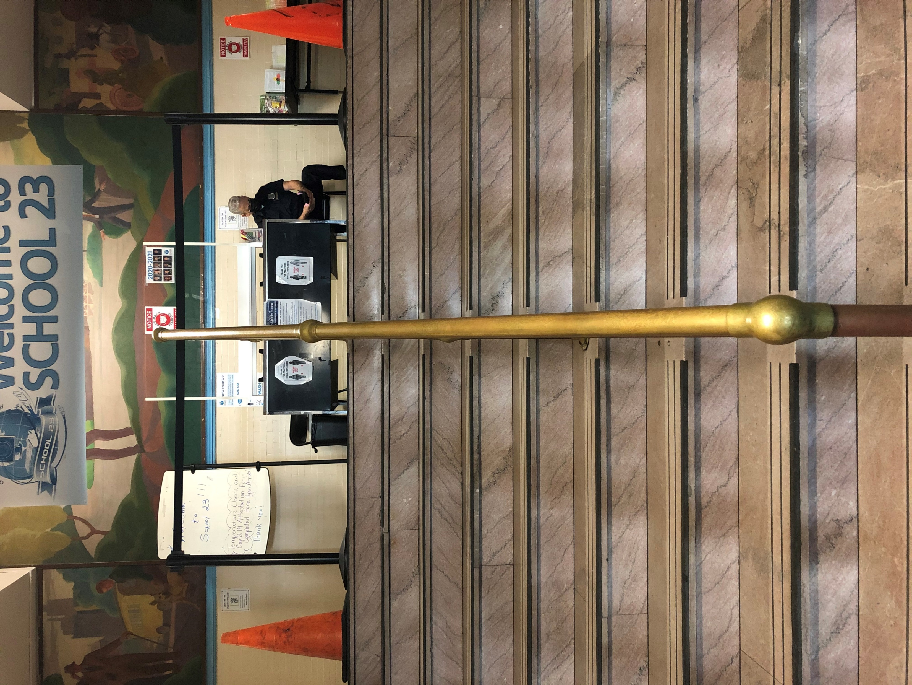
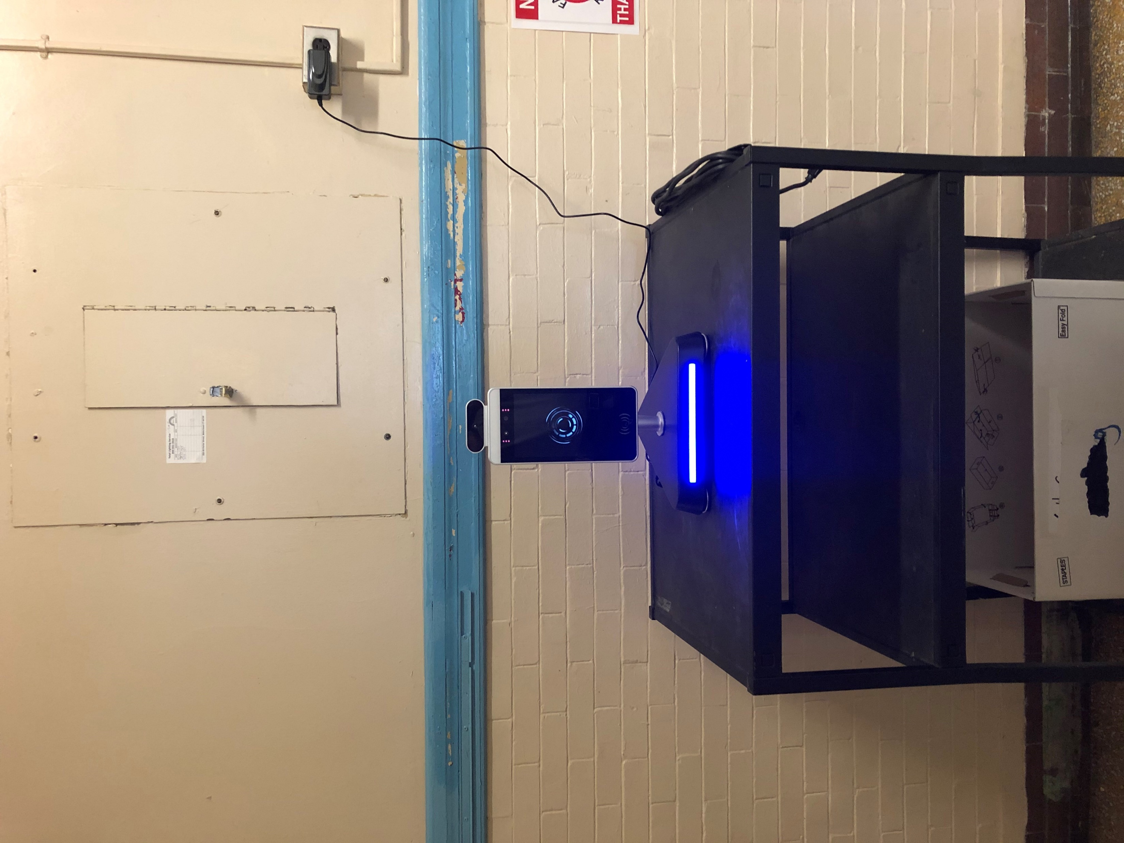
*As students enter the building they will stay on the left side or right side as assigned and have their temperature taken by staff or at the temperature kiosk
Main Entrance Inside Stairs – Left Walkway and Right Walkway with temperature Kiosk
Left
Right

Slide 11
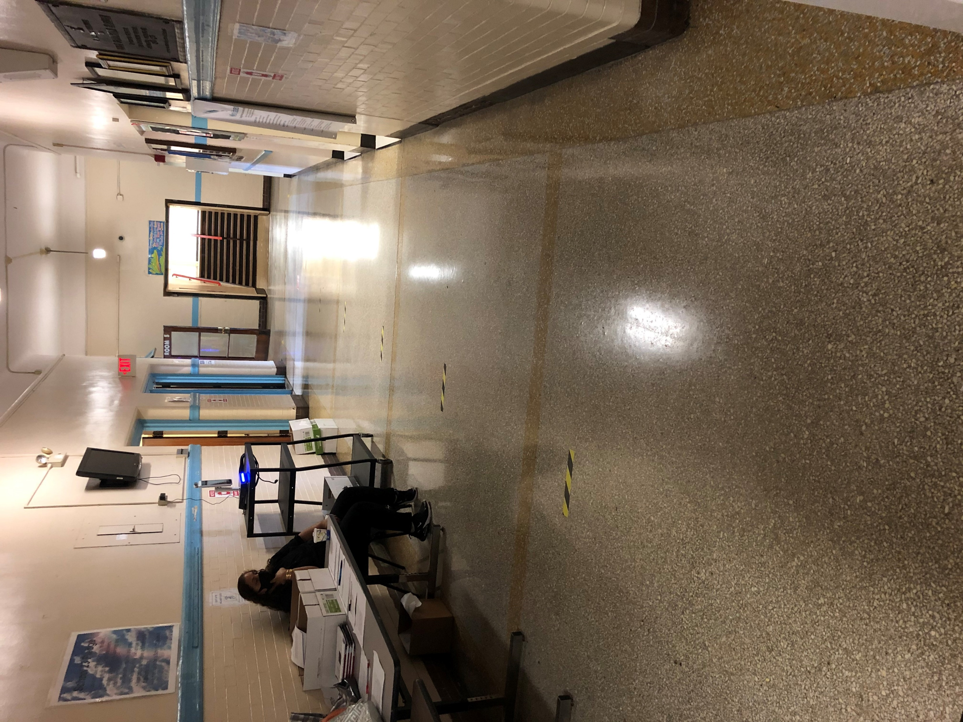
1st Floor Hallway Right Walkway
*Students entering through the right walkway will go through the right hallway, pick up their breakfast in a bag at the table and continue to their class, assisted by our staff while maintaining social distance
Right

Slide 12
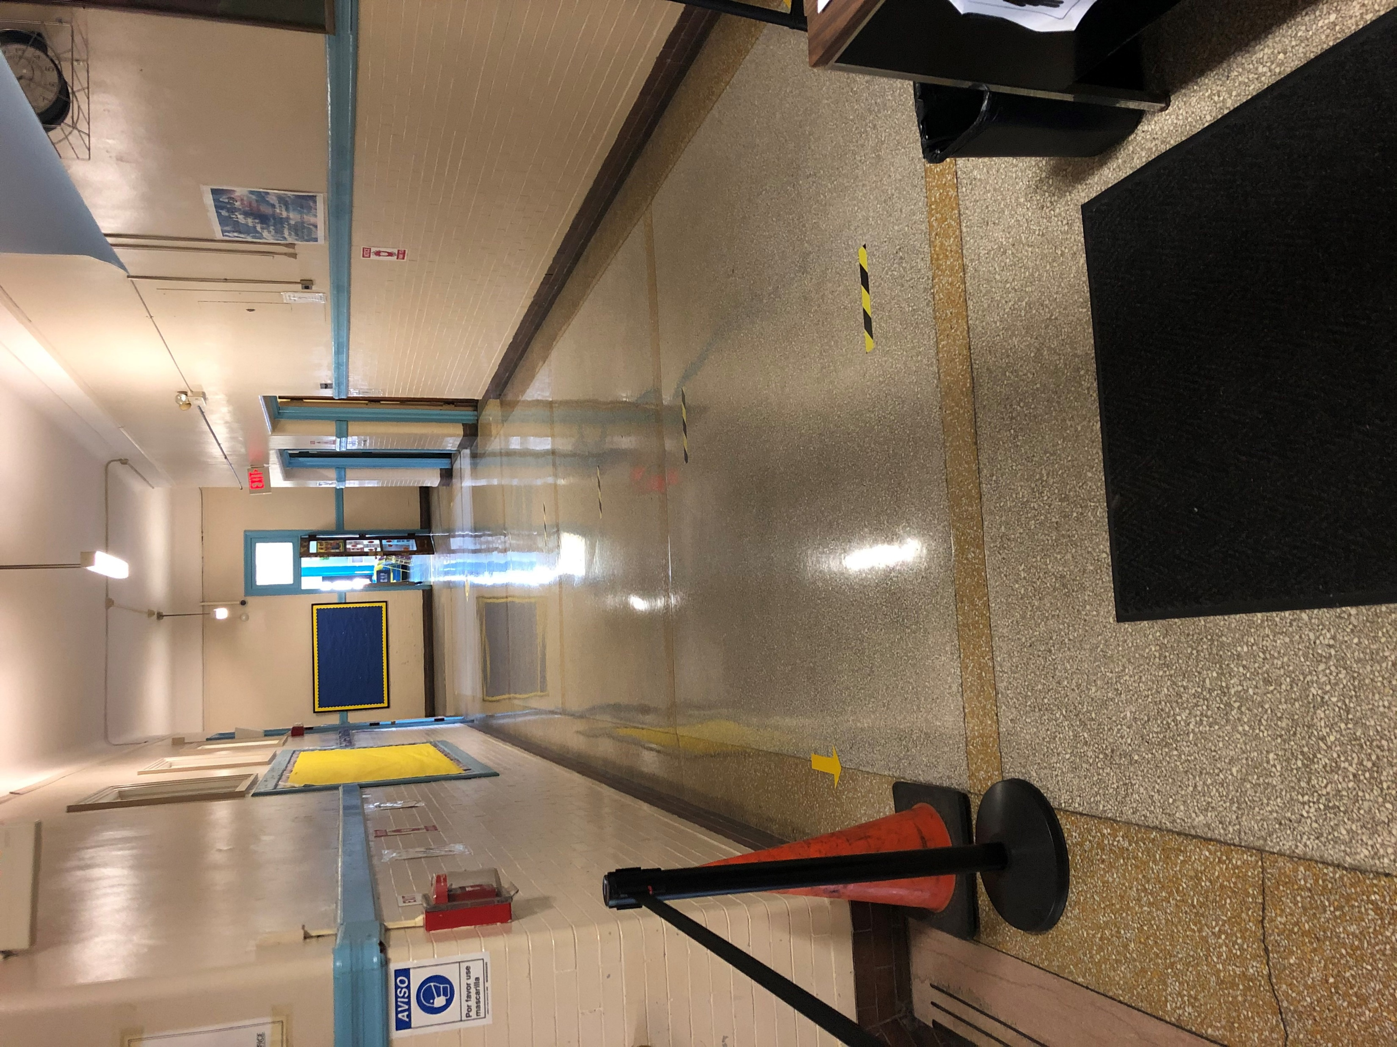
1st Floor Hallway Left Walkway
*Students entering through the left walkway will use the left hallway to pick up their breakfast in a bag and continue to their class assisted by our staff while maintaining social distance
Left

Slide 13
P.M. DISMISSAL PROCEDURES
2:40pm – 3:15pm

Slide 14
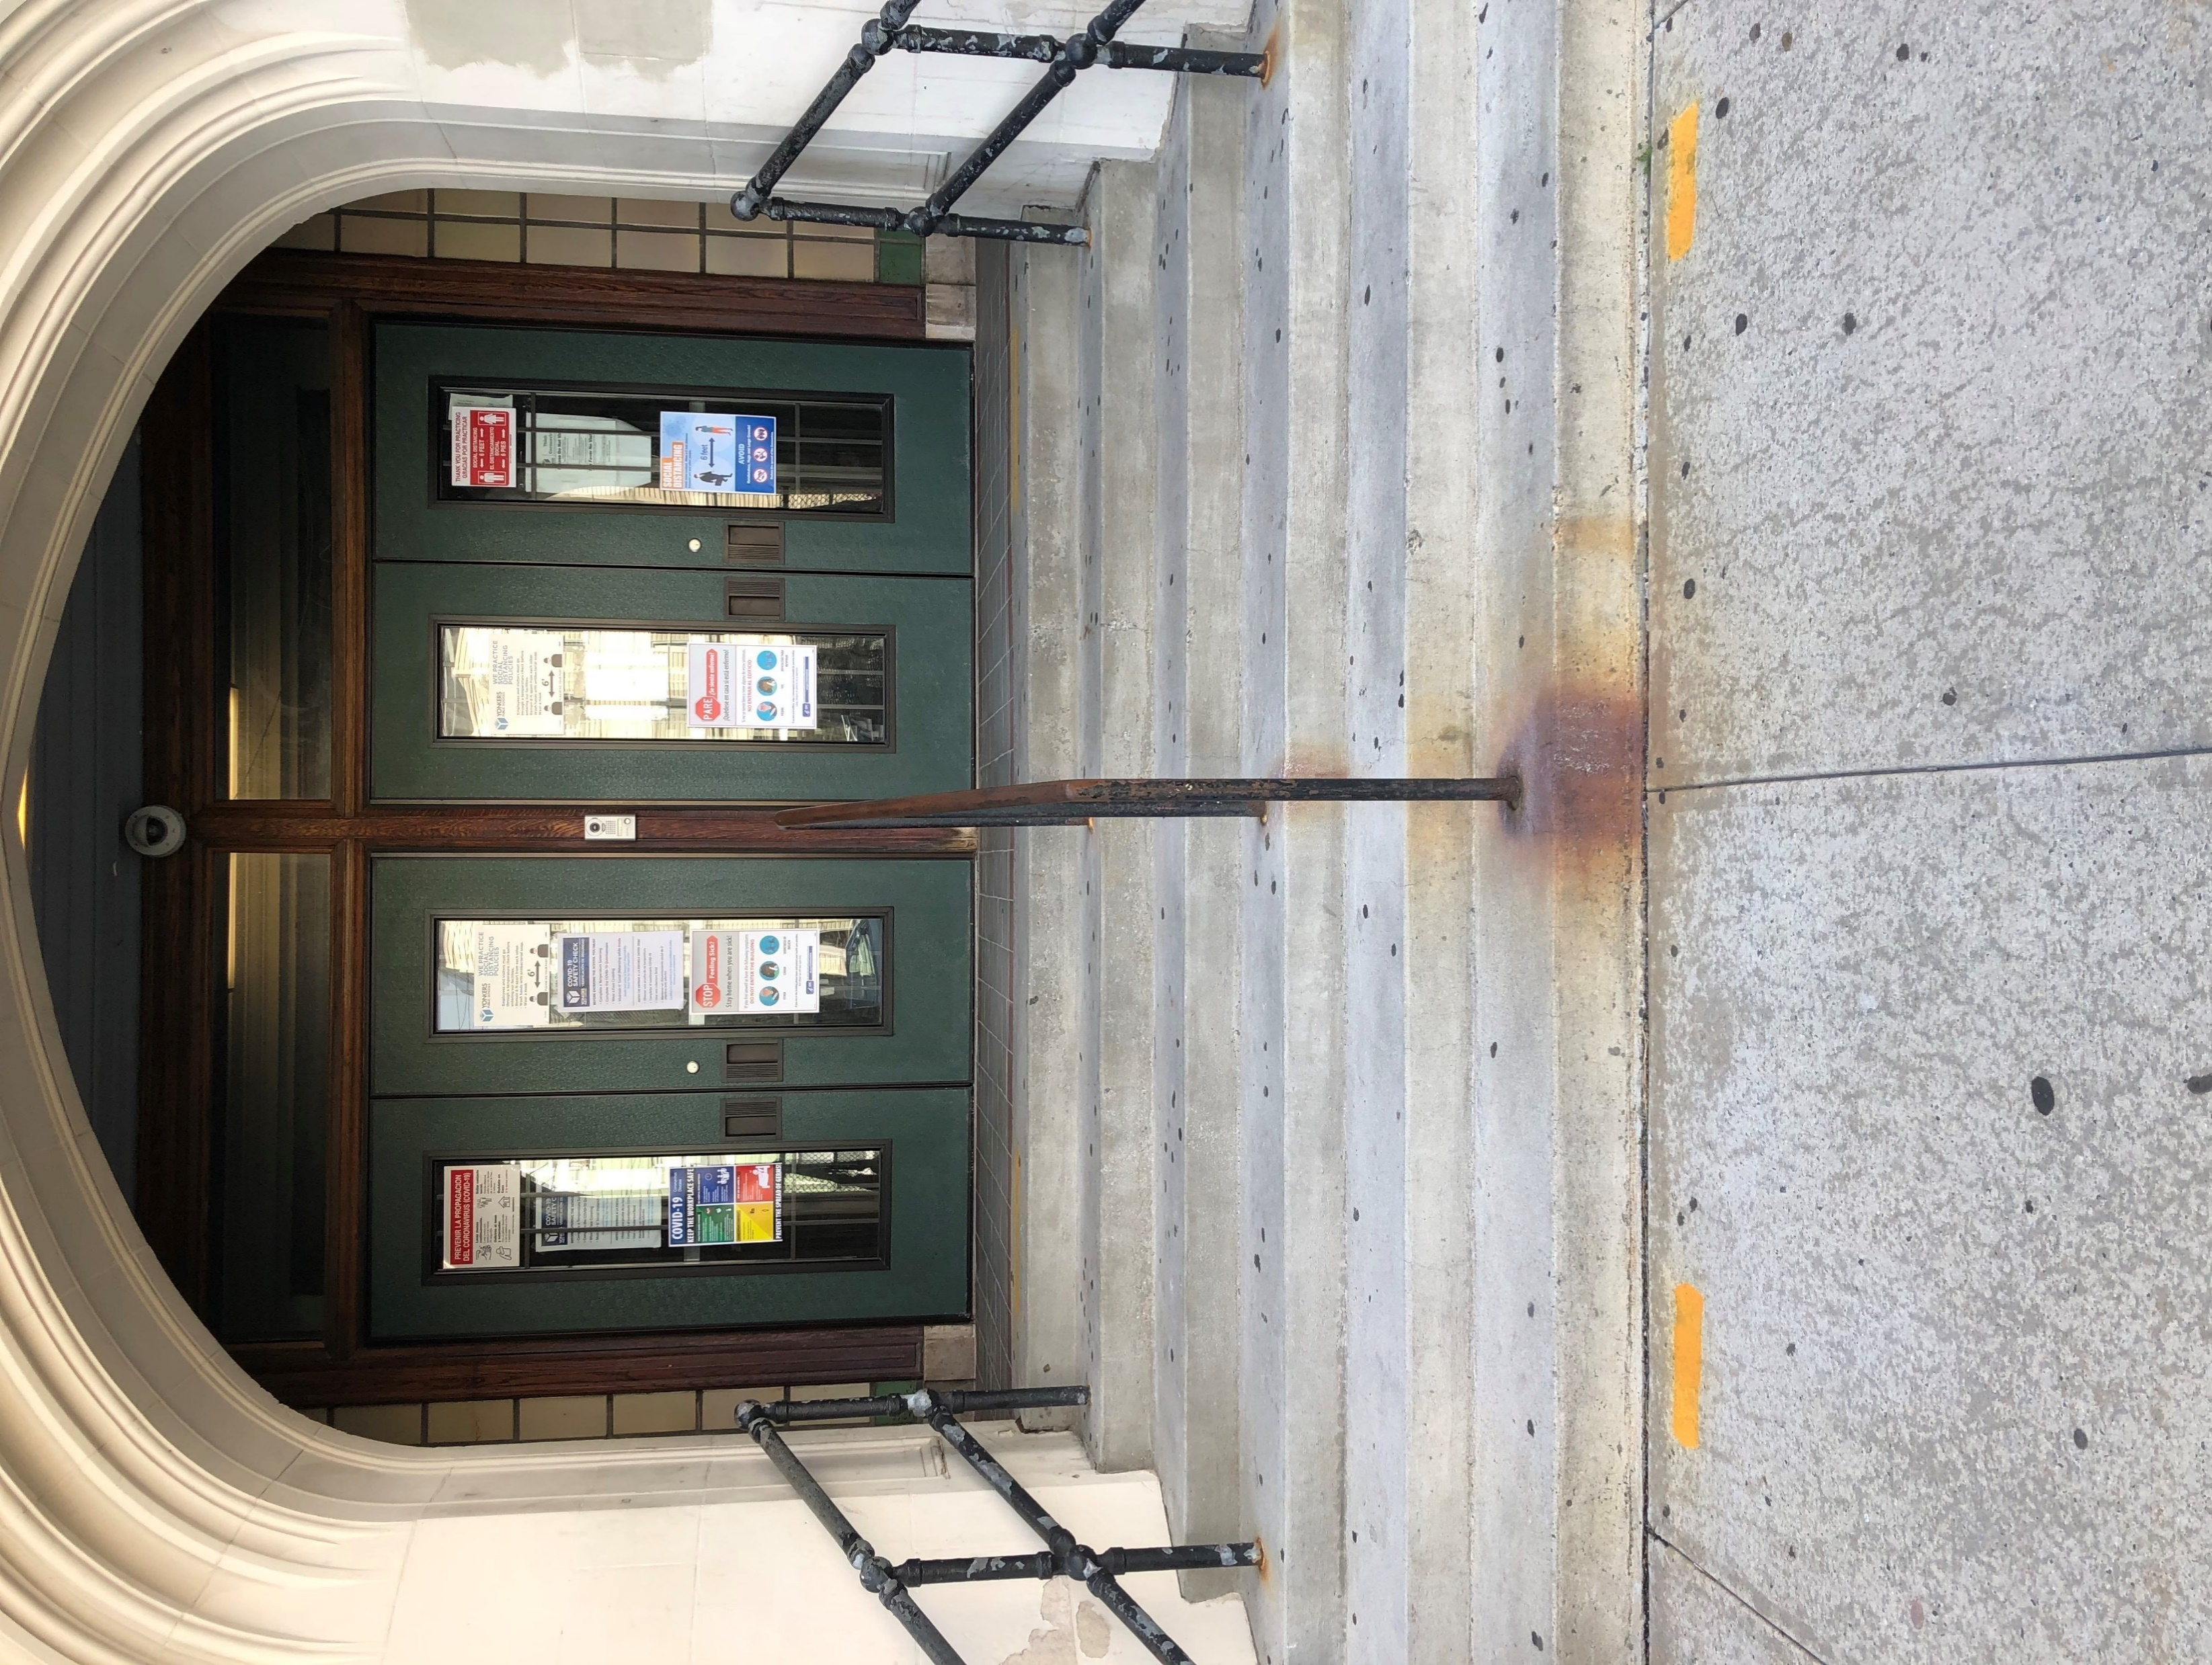
Main Entrance to Van Cortlandt Ave.
Bus Dismissal– 2:55pm – 3:15pm
Kindergarten – 2:40pm
4th Grade – 2:50pm

Slide 15
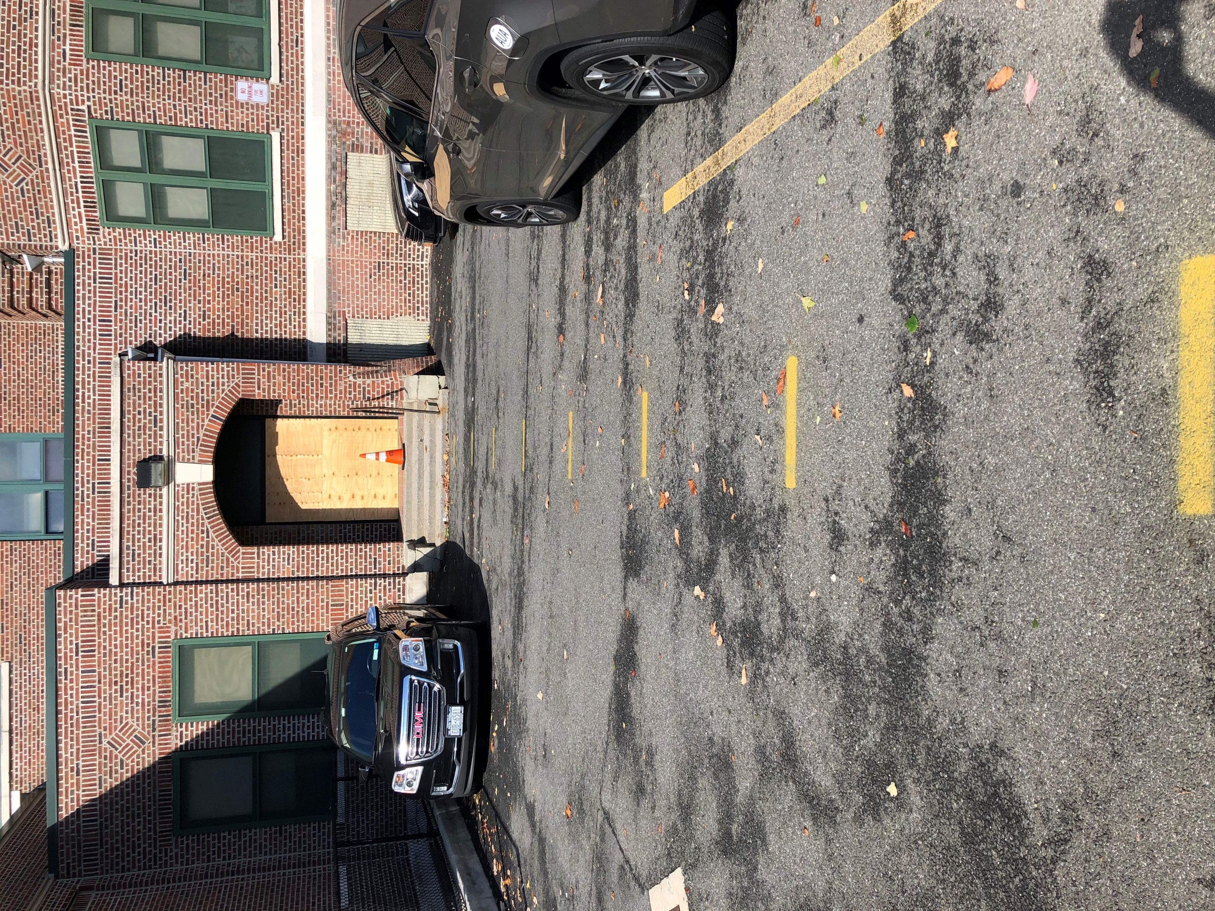
Stairwell 1 Exit to Parking Lot
(Grades PK-2 -Sign-Out Required; Grade 3 – Guardian required)
PK – 2:40pm
1st Grade – 2:45pm
2nd Grade – 2:55pm
7th Grade – 3:10pm
8th Grade – 3:15pm

Slide 16
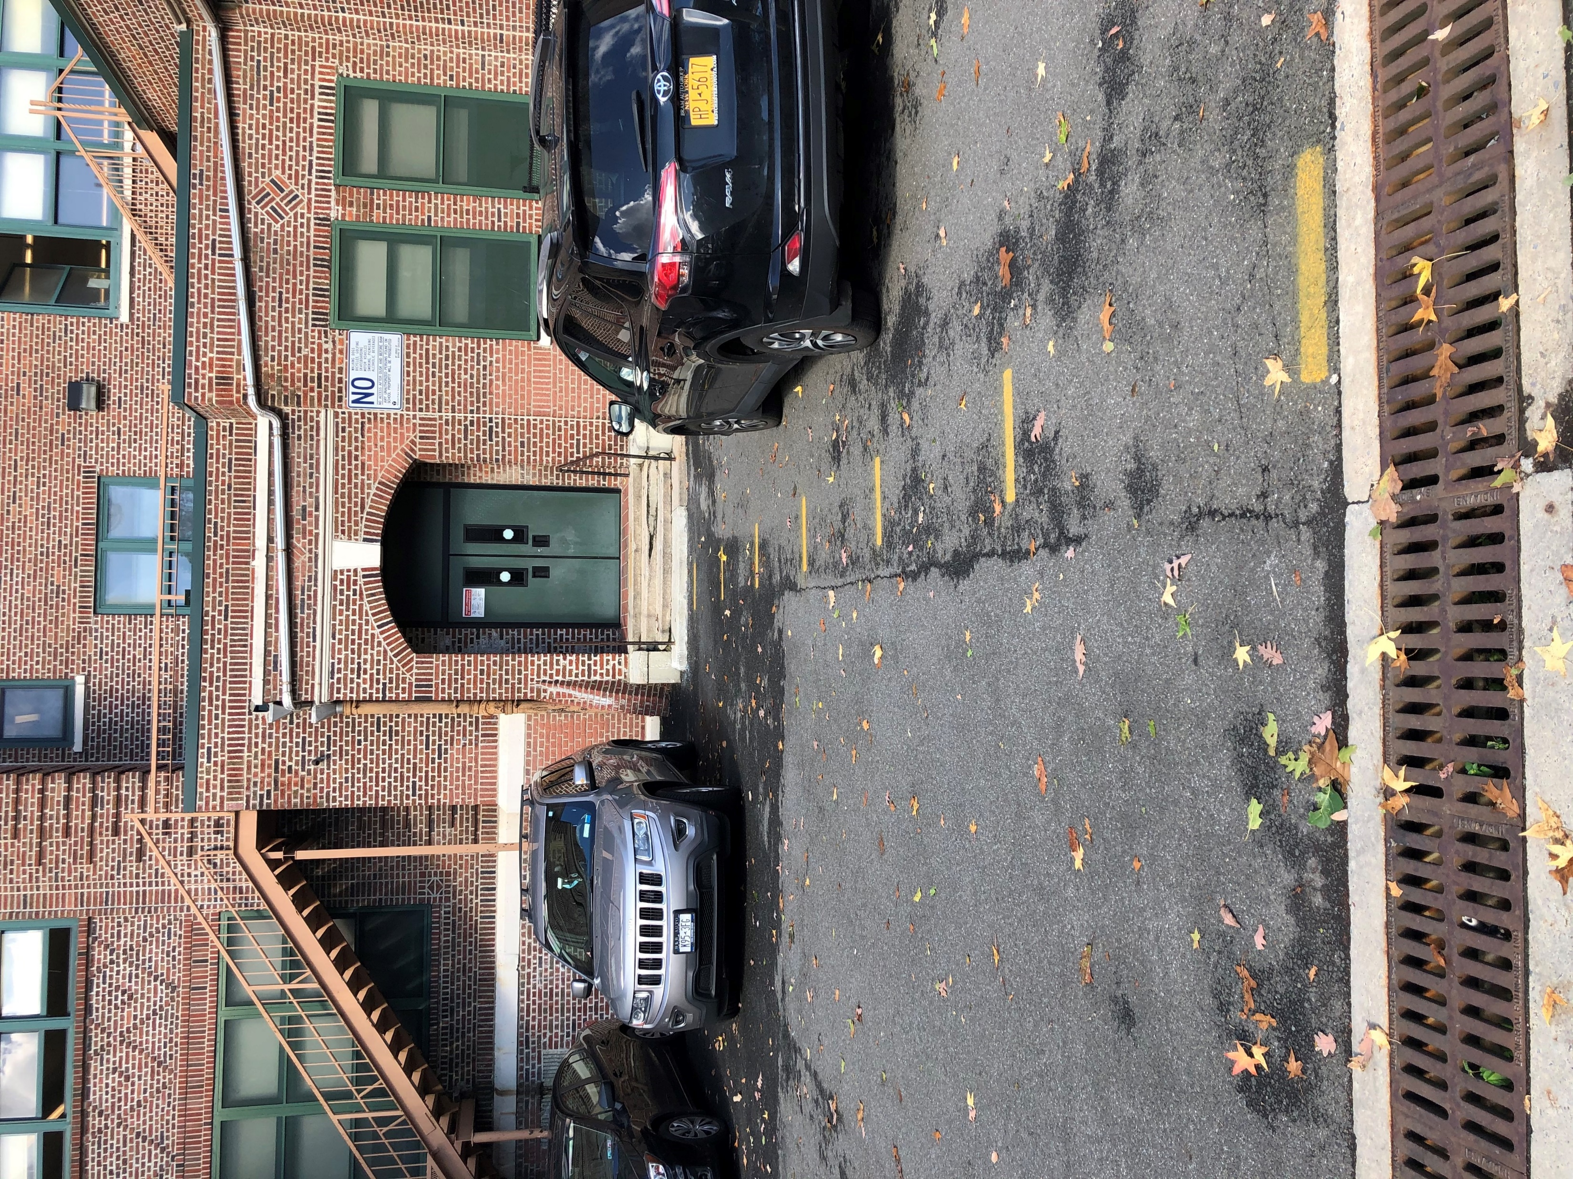
Stairwell 2 Exit to Parking Lot
(Grade 3 – Guardian required)
3rd Grade – 2:45pm
5th Grade – 2:55pm
6th Grade – 3:05pm

